Slide 1
Dynamics
of
Polarization Rhetoric
Presented by M. Shahid Modi for Frontiers of Network Science
With thanks to Dr. Szymanski (Advisor)
Rensselaer Polytechnic Institute, NeST Center

Slide 2
Tweet: The Green group is making actual progress with the funding bill. If you’re in Purple, you’re against progress. SAD!
Why is this tweet so divisive and aggressive?
Social media influencers are known to use divisive (in-group vs out-group) rhetoric. Why?

Slide 3
Why would someone be divisive online? Let’s discuss!
Motivation
Can we hypothesize how and why?
Can we categorize social media posts?
Can we analyze dynamics using those posts?

Slide 4
The anatomy of polarizing language
Today, we’re looking at, “Dynamics of Polarizing Rhetoric in Congressional Tweets” by Ballard et al, who give the following example tweet:
Last night, Twitter censored @[user] for suggesting children are far less susceptible to COVID-19 than adults—a well-known fact—because it goes against the [out-group] agenda to keep schools closed, people out of work, and destroy our economy to influence the election.
What polarizing elements are present?
Taps into the social identity of the in-group
Mentions powerful in-group member
Mentions out-group as comparison
Negative tone towards out-group

Slide 5
Humans do well at finding polarization
Bollard et al. analyzed tweets in the 111th–116th congresses (2009–2020), during which members of Congress ~five million tweets .
They combined these data with information about members, their constituents, and the political environment
They asked four researchers to categorize 4,000 tweets into polarizing and non-polarizing.
The researcher’s categorizations were compared against each other.
They agreed 85% of the time.

Slide 6
…Transformer Models do better
The authors utilizes RoBERTa: a powerful transformer-based method for building context-aware embeddings (Liu et al 2019)
With RoBERTa, the vectorized representation of a word changes based on context.
Each tweet put through RoBERTa also has its own embedding layer to fine-tune.
They fine-tuned the sequence embedding for classifying polarizing rhetoric in tweets.
They used 3200 tweets (80%) randomly sampled from training data to tune the model, with weights to address the unbalanced nature of the data.
Overall, the model is highly accurate: the out-of-sample predictive accuracy is 90% with a weighted F1 score of 0.9

Slide 7
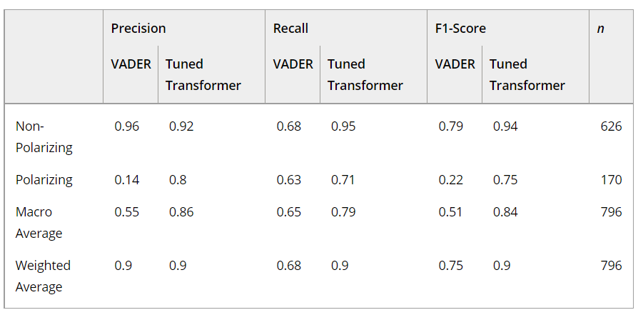
Fig: Transformer vs VADER (Valence Aware Dictionary and Sentiment Reasoner), a commonly-used dictionary-based sentiment analysis tool that is designed for use on social media (Hutto and Gilbert 2014).

Slide 8
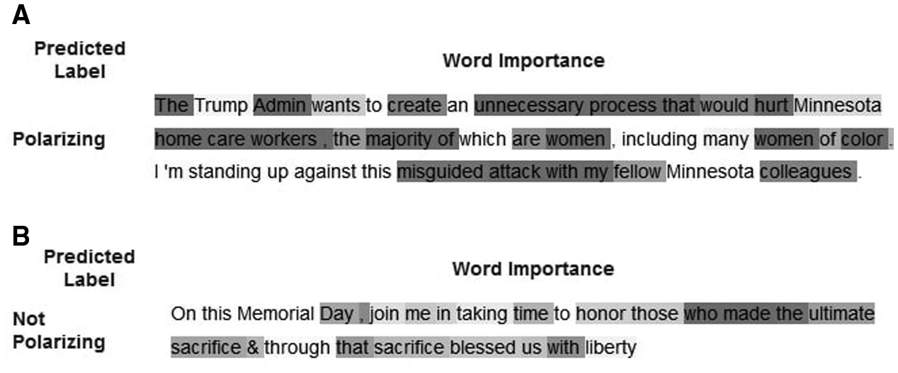
How RoBERTa categorizes tweets
Prediction Attribution Using Integrated Gradients Note: The shaded tokens contributed to the predicted label to a degree relative to the depth of their shading.

Slide 9
Why would someone be divisive online?
Motivation
Revisited
Can we hypothesize how and why?
Can we categorize social media posts?
Can we analyze dynamics using those posts?

Slide 10
Five hypotheses on how and why!
Hypothesis 1.Polarizing tweets sent by members of Congress will receive more engagement than non-polarizing tweets sent by members of Congress.
Hypothesis 2.More ideologically extreme members of Congress will be more likely to use polarizing rhetoric in their tweets.
Hypothesis 3.Members in safer electoral situations will be more likely to use polarizing rhetoric in their tweets.
Hypothesis 4.Members of Congress who are not in the president’s party will be more likely to use polarizing rhetoric in their tweets than those in the president’s party
Hypothesis 5.Polarizing tweets from members of Congress will lead to increased campaign donations.

Slide 11
Modelling – OLS Regression
Take various internal data metrics such as likes and retweets.
Collect external data such as campaign donation data.
Decide best dependent variables and independent variable for the Ordinary Least Squares regression.
Example: H1 (Engagement) – Dependent variables were likes or retweets.
The dependent variable is measured relative to the average number of likes/retweets received.
The authors’ main independent variable is a dummy variable for whether tweets were polarizing.

Slide 12
Model outcomes – Hypothesis I (Engagement)
Fig: Coefficients and 95% Intervals for the Effect of Polarizing Rhetoric on Tweet Engagement from Models Estimated Separately by Year, in Terms of Percentage Likes Above Average (Top) and Retweets Above Average (Bottom) Note: Dashed lines are fitted local regression lines estimated via LOESS.

Slide 13
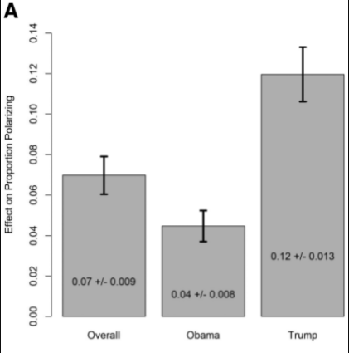
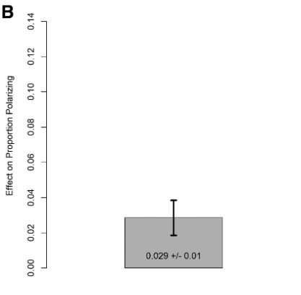
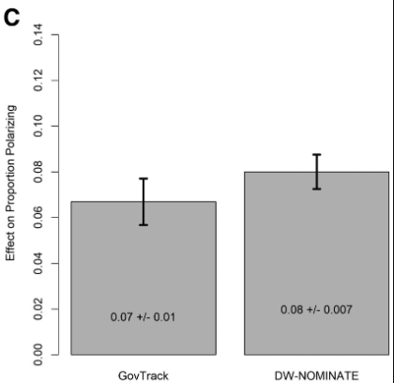
Model outcomes – Hypothesis II-IV
(Opposition, Safety, Extremity)
Fig: Effect on the the Proportion of Members’ Tweets that were Polarizing of (a) Membership in the Party Opposite the President (b) Electoral Safety, and (c) Ideological Extremity Notes: Black vertical lines are 95% uncertainty estimates. All y-axes are on the same scale, and effects of continuous variables (electoral safety and ideological extremity) are in terms of an increase of two standard deviations in each variable.

Slide 14
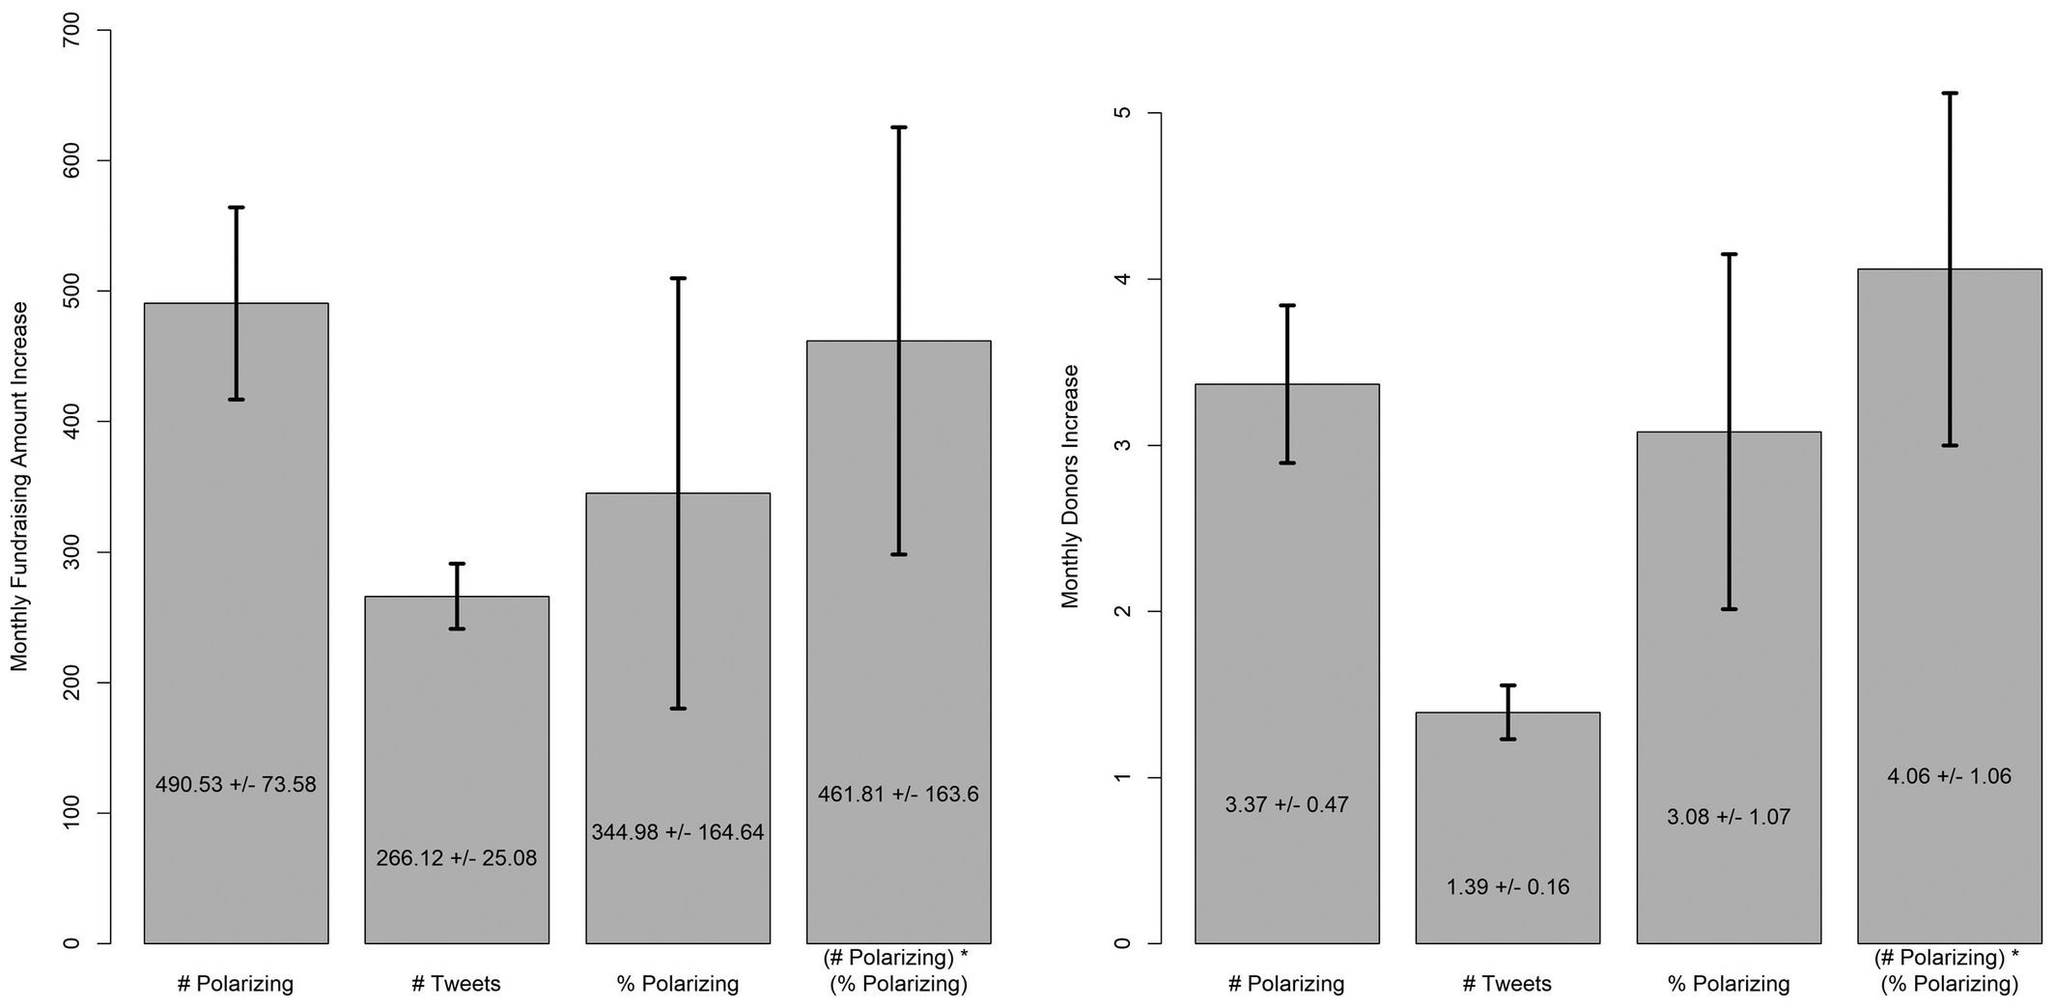
Model outcomes – Hypothesis V (Donations)
Fig: Coefficients and Uncertainty Estimates from Models Predicting Dollars Donated (Left) and Number of Individual Donors (Right) to Members’ Campaigns in a Given Month, Based on the Number of Polarizing Tweets and Total and Total Tweets Sent, as Well as the Proportion of Polarizing Tweets and the Proportion of Polarizing Tweets Multiplied by the Number of Polarizing tweets.

Slide 15
So… How polarized is Twitter?
It is an open question how the polarizing rhetoric of political influencers affects the platform’s group dynamics.
However, Twitter users have been studied in longitudinal studies to estimate their political bias dynamics.
Based on this eternal group analysis, it was shown that Twitter is Bimodal, with opposing large groups on two sides of the aisle.
We created a flow diagram to show user group movements over time as well.

Slide 16
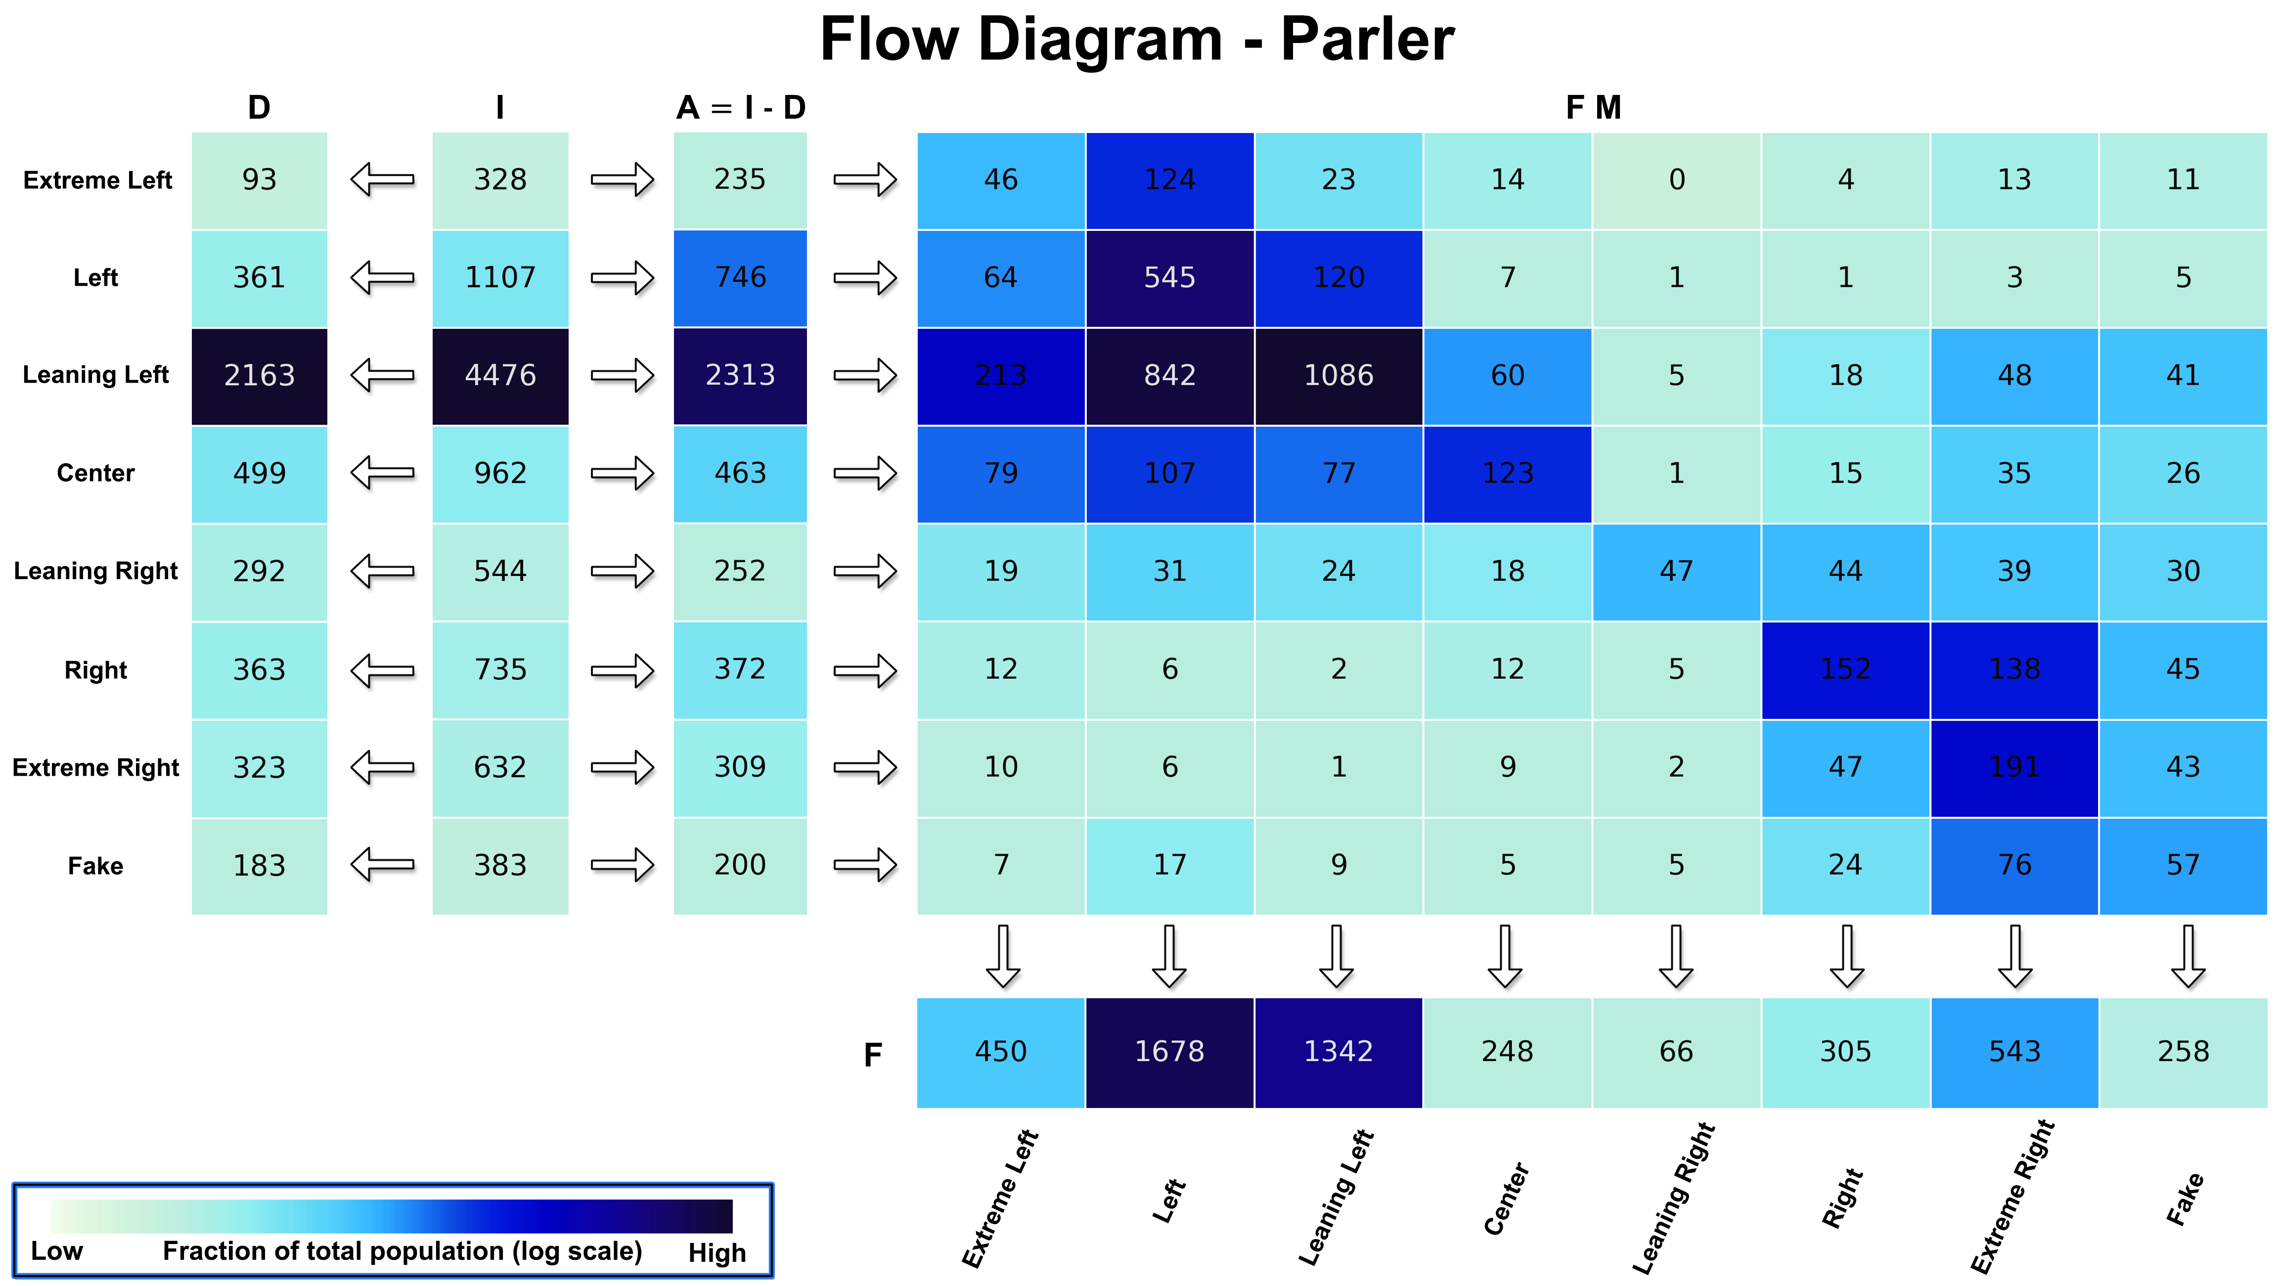

Slide 17
Conclusion
Congressional members on Twitter used polarizing rhetoric to empower their reach and strengthen their platforms.
The authors used a transformer model to categorize tweets.
They used a number of OLS regression models to see how beneficial divisive speech was across five paradigms.
Polarizing rhetoric may play a role in the strongly polarized bias groups on Twitter.

Slide 18
References:
Ballard, A.O., DeTamble, R., Dorsey, S., Heseltine, M. and Johnson, M. (2023), Dynamics of Polarizing Rhetoric in Congressional Tweets. Legislative Studies Quarterly, 48: 105-144. https://doi.org/10.1111/lsq.12374
Liu Zhuang, Lin Wayne, Shi Ya, and Zhao Jun. 2021. A Robustly Optimized BERT Pre-training Approach with Post-training. In Proceedings of the 20th Chinese National Conference on Computational Linguistics, pages 1218–1227, Huhhot, China. Chinese Information Processing Society of China.
Hutto, C., & Gilbert, E. (2014). VADER: A Parsimonious Rule-Based Model for Sentiment Analysis of Social Media Text. Proceedings of the International AAAI Conference on Web and Social Media, 8(1), 216-225. https://doi.org/10.1609/icwsm.v8i1.14550

